Slide 1
Detectors calibration and adjustment with android platform. (using RS-BL converter)

Slide 2
The converter consists of two independent converters inside:
Converter RS-485 in a USB (hereinafter referred to as RS), ensuring the connection of the detector to the Android device over the wire communication line;
Converter RS-485 in Bluetooth (hereinafter referred to as BL),ensuring the connection of the detector to the Android device over the wireless network.

Slide 3
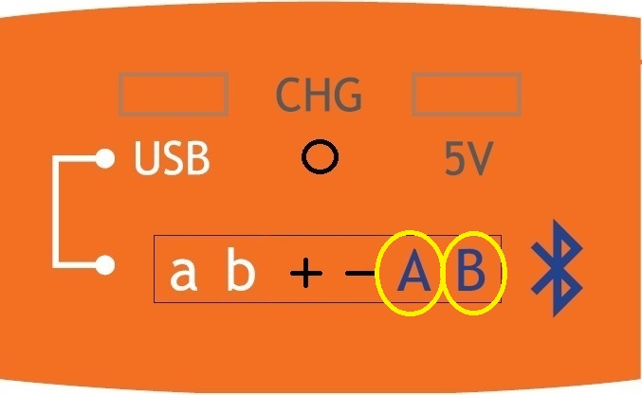
Converter RS-485 in Bluetooth (BL)
Connecting one end of the cable (included in to the delivery set) to the RS-BL (red cable to the „A“,black to the „B“BL converter connection terminal ) and another end to the sensor.

Slide 4
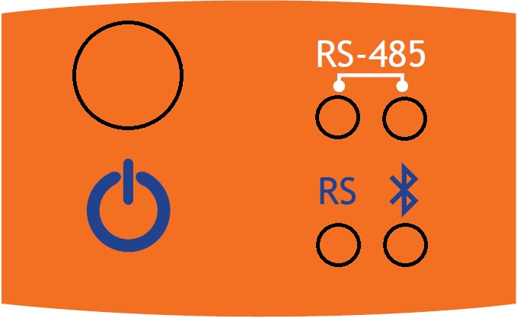
Converter RS-485 in a Bluetooth (BL)
Turn ON Forteza RS-BL
(Press power button).
Then the indicator „RS“
glow it's mean that
connection is correct.
While indicator „RS“
lights,bluetooth rarely blinks.(ready to connection)

Slide 5
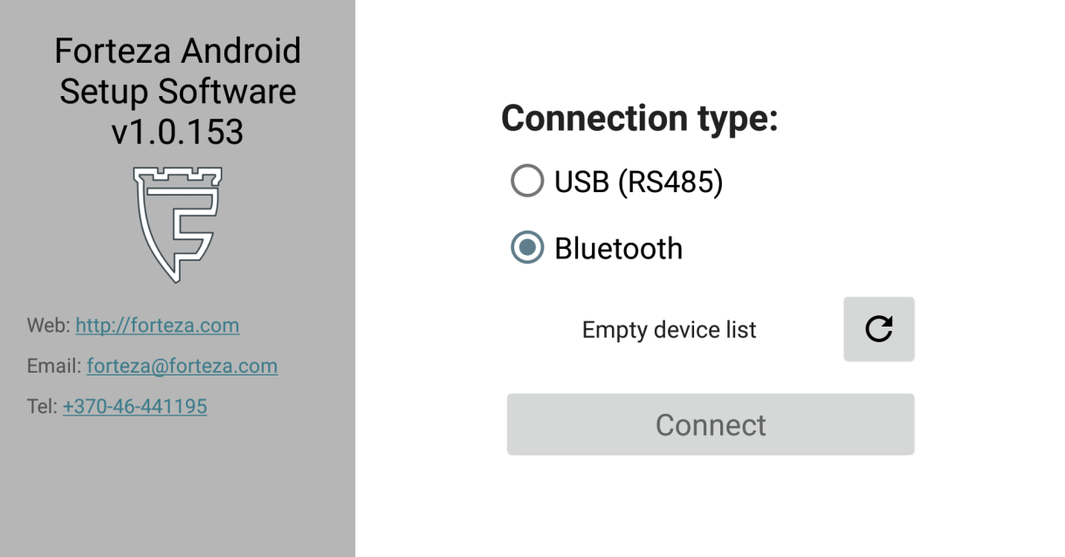
Converter RS-485 in a Bluetooth (BL)
Turn on FORTEZA FMC software (which you can download for free from the Google play)
On the first screen you will be see connection type.
Select “Bluetooth”,find and choose your RS-BL (number is written on the product) and click “Connect”.

Slide 6
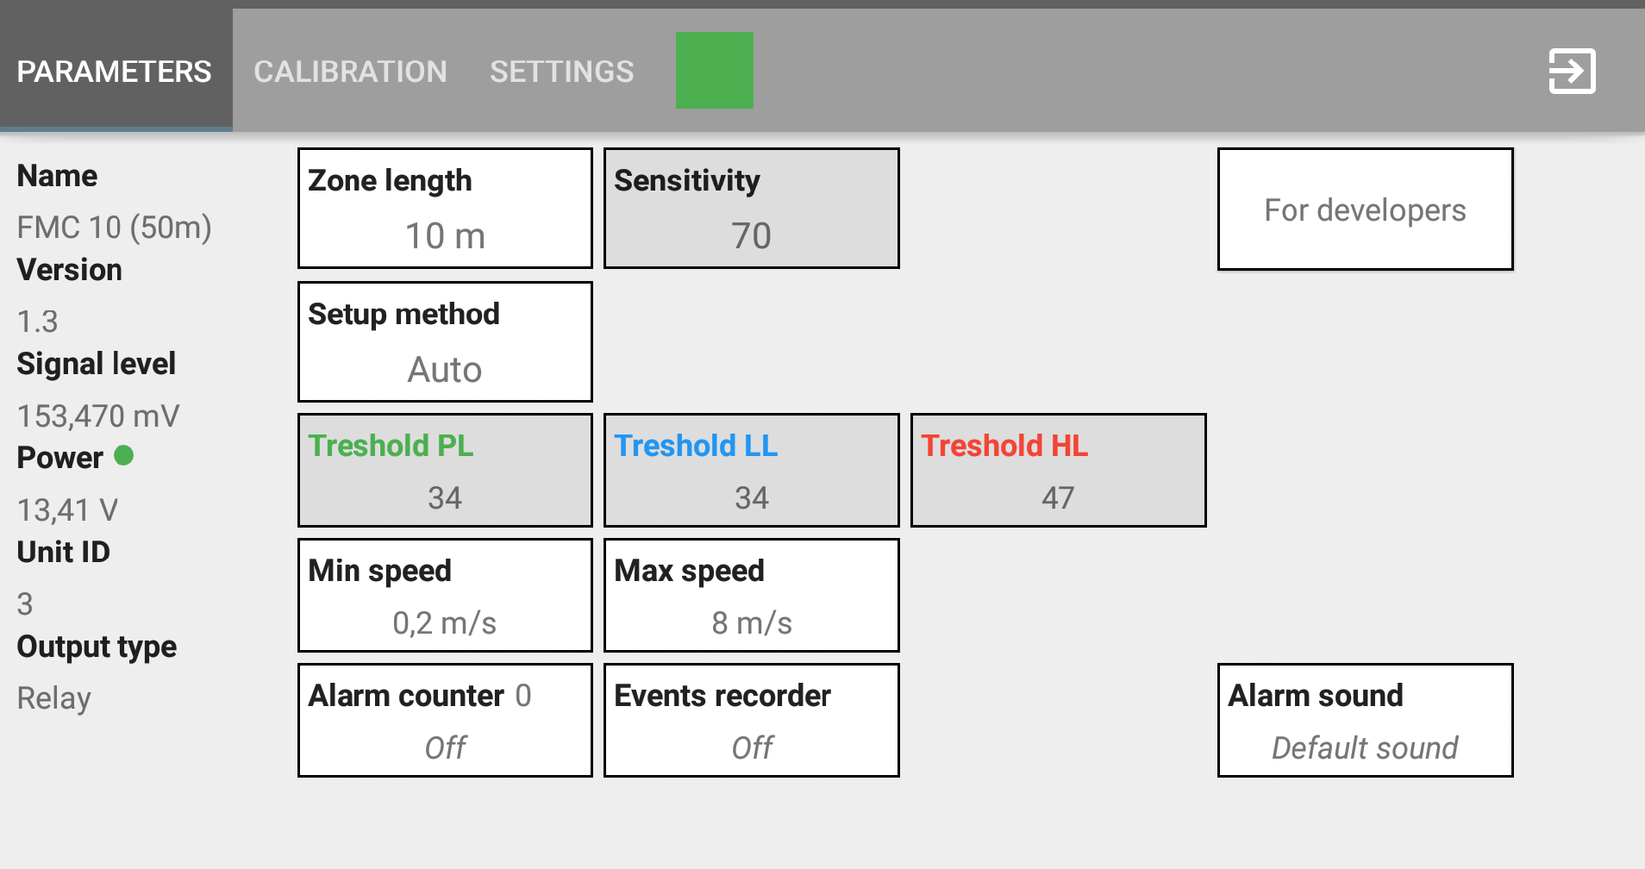
Converter RS-485 in a Bluetooth (BL)
About parameters

Slide 7
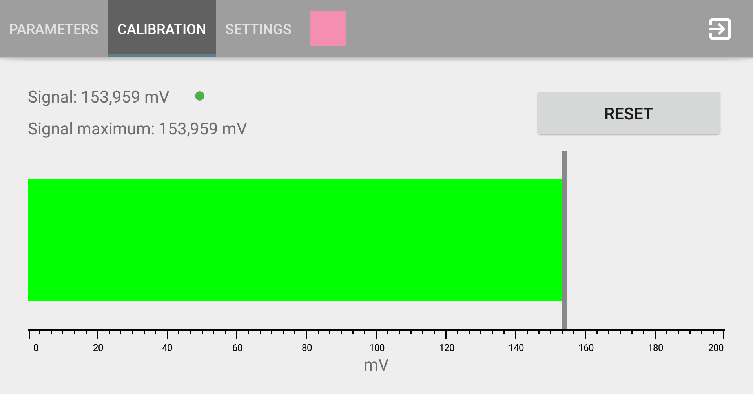
Converter RS-485 in a Bluetooth (BL)
About calibration

Slide 8
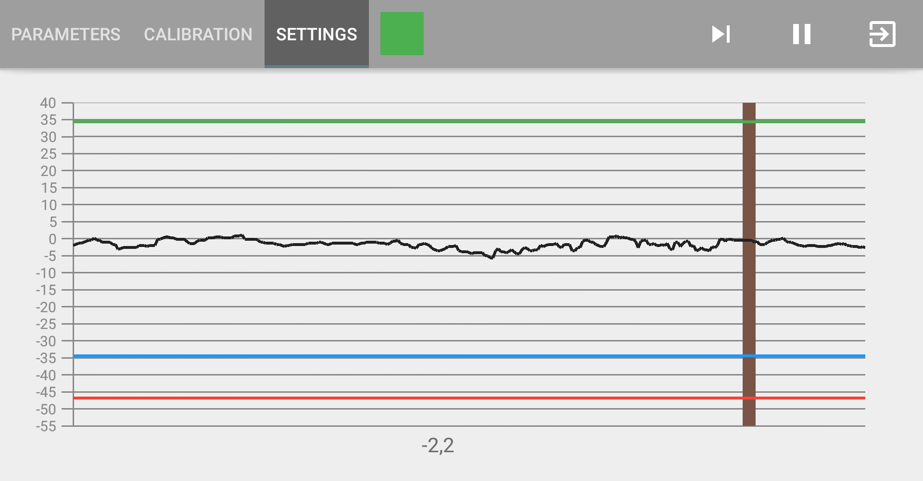
Converter RS-485 in a Bluetooth (BL)
About settings

Slide 9
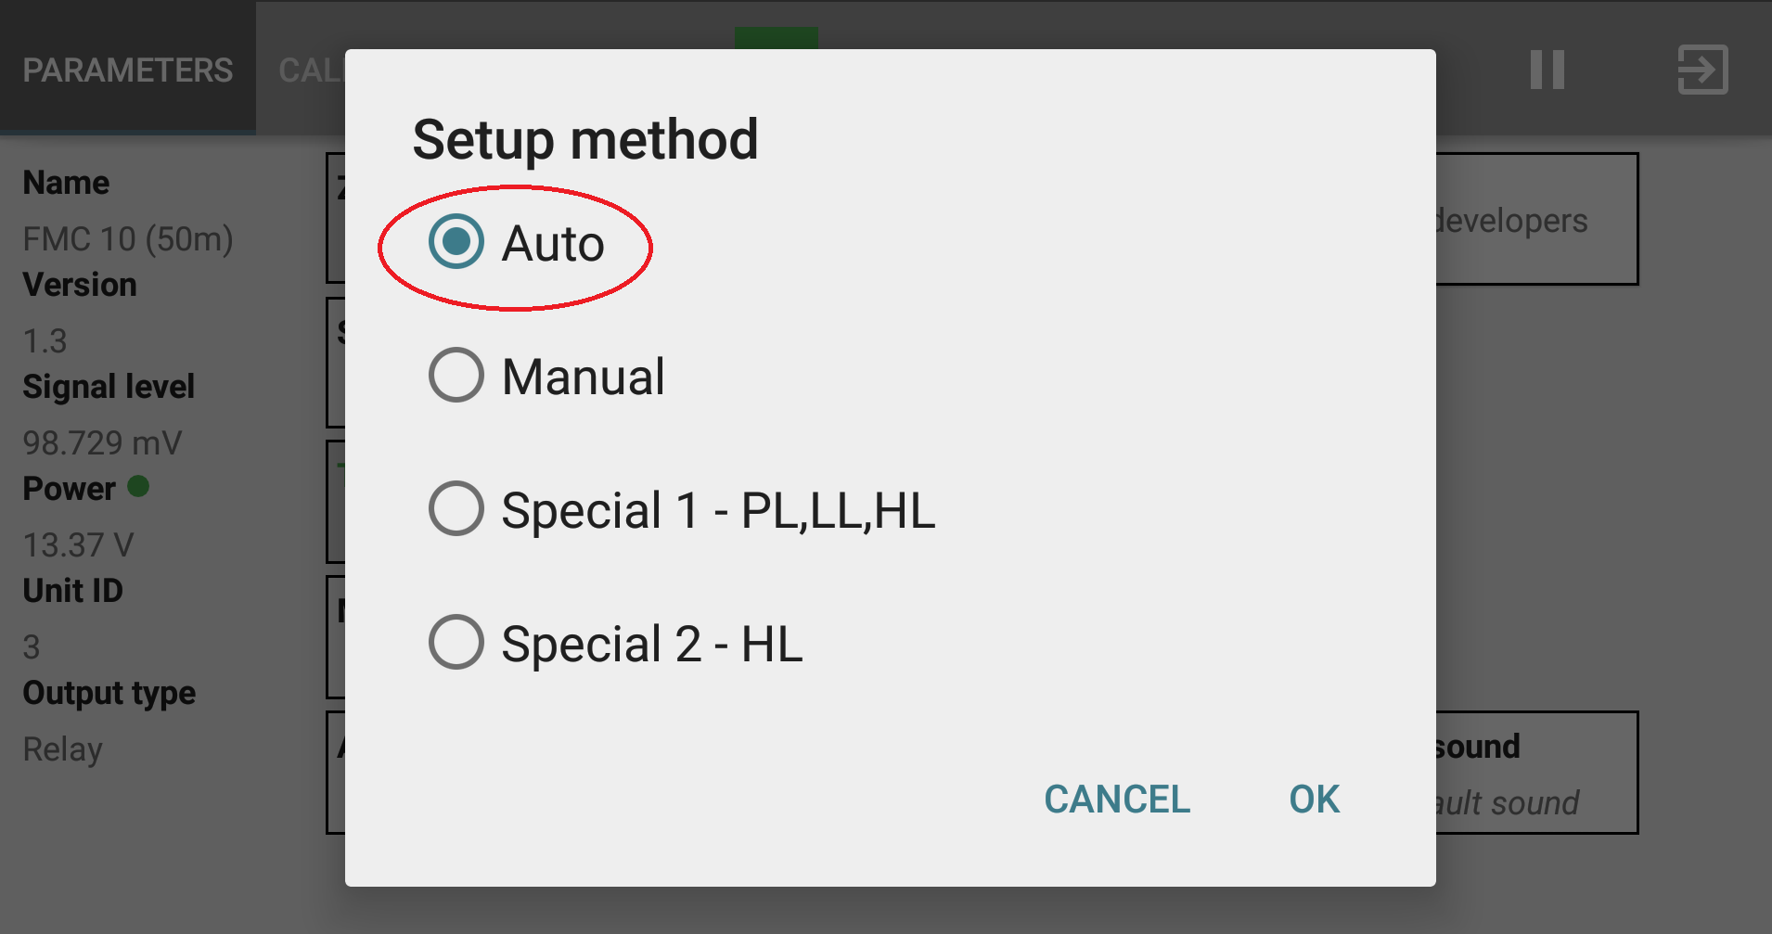
Converter RS-485 in a Bluetooth (BL)
Setup method: Auto

Slide 10
Converter RS-485 in a Bluetooth (BL)
In the SETTINGS you will see :

Slide 11
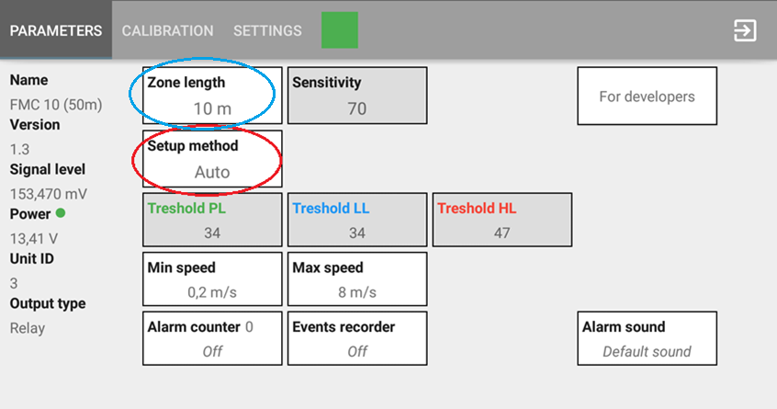
Converter RS-485 in a Bluetooth (BL)
In the AUTO you can change zone lenght:

Slide 12
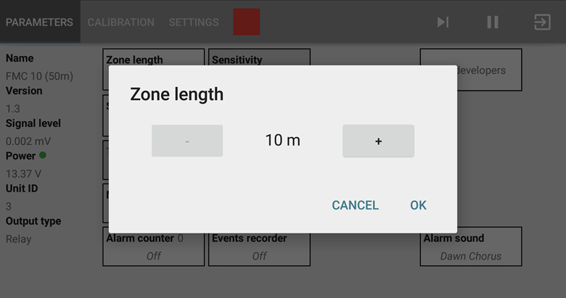
Converter RS-485 in a Bluetooth (BL)
In the AUTO you can change zone lenght:

Slide 13
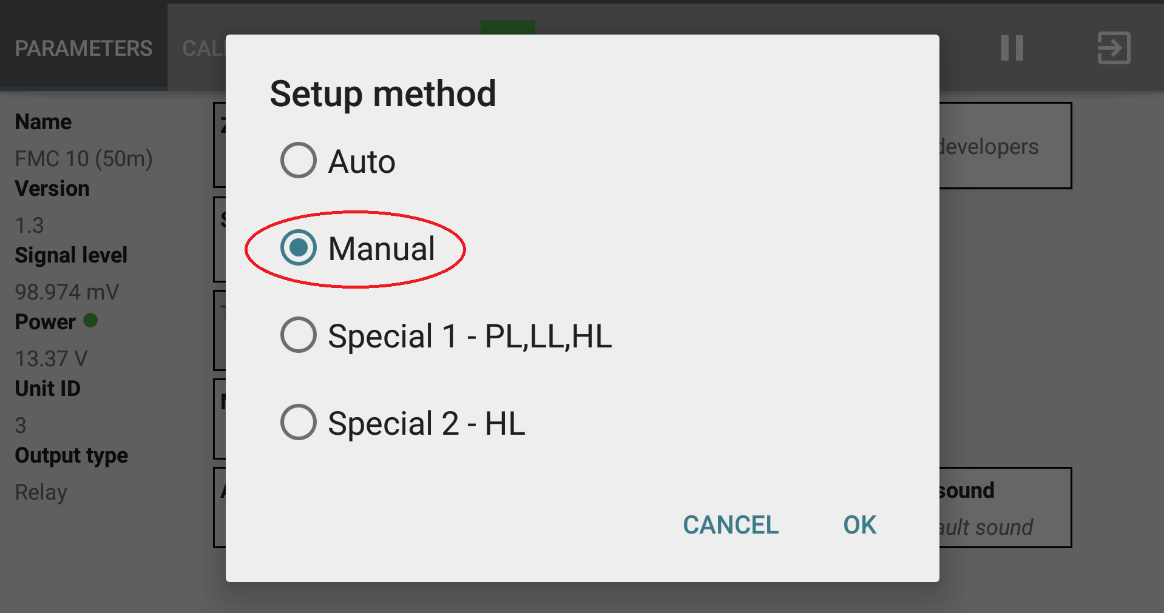
Converter RS-485 in a Bluetooth (BL)
Then you choose setup method: Manual

Slide 14
Converter RS-485 in a Bluetooth (BL)
In the SETTINGS you will see :

Slide 15
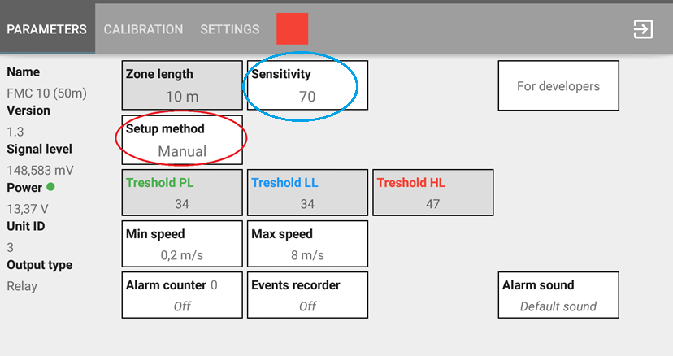
Converter RS-485 in a Bluetooth (BL)
In the manual method, we can choose SENSITIVITY

Slide 16
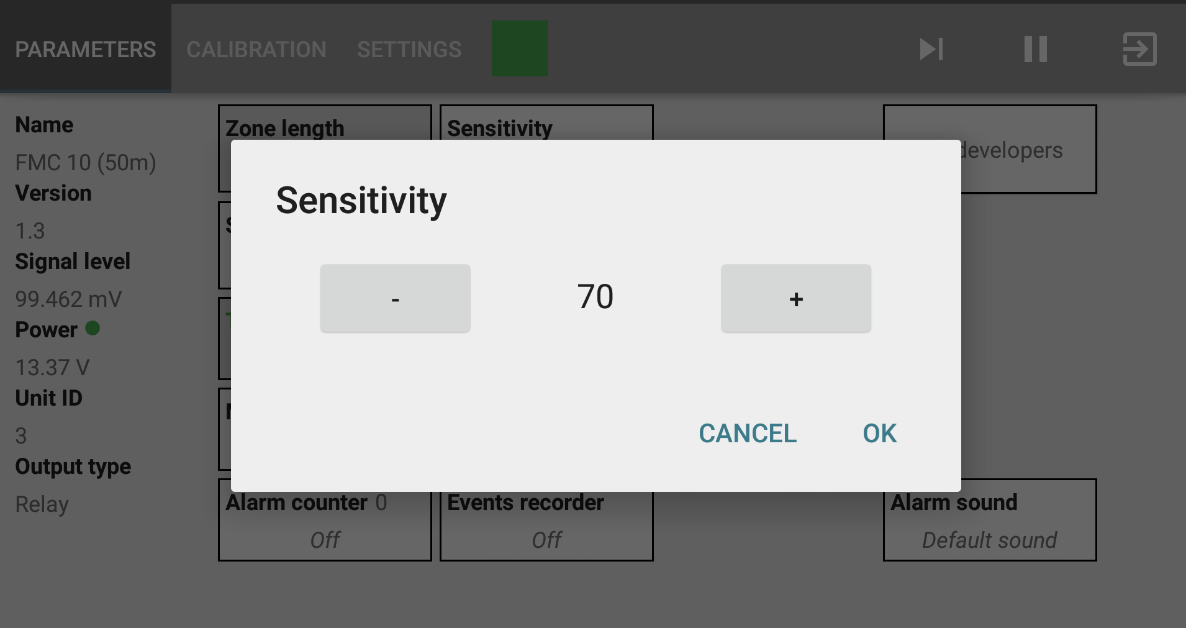
Converter RS-485 in a Bluetooth (BL)
In the manual method, we can choose SENSITIVITY

Slide 17
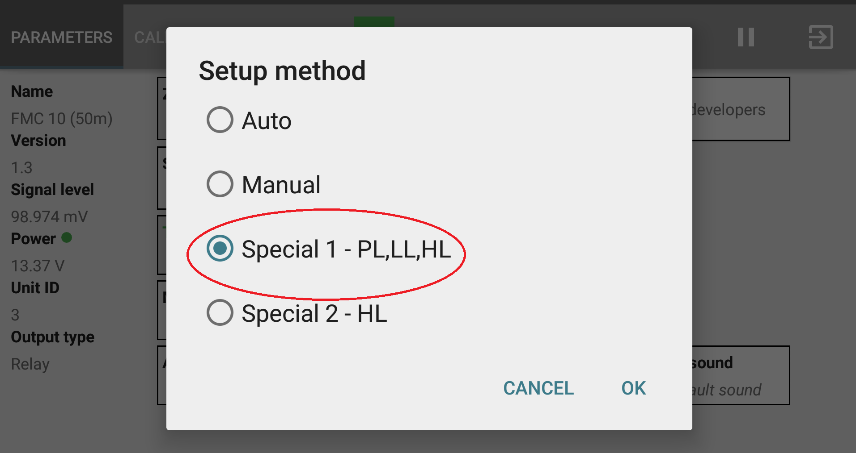
Converter RS-485 in a Bluetooth (BL)
Then you choose setup method: Special 1 – PL,LL,HL

Slide 18
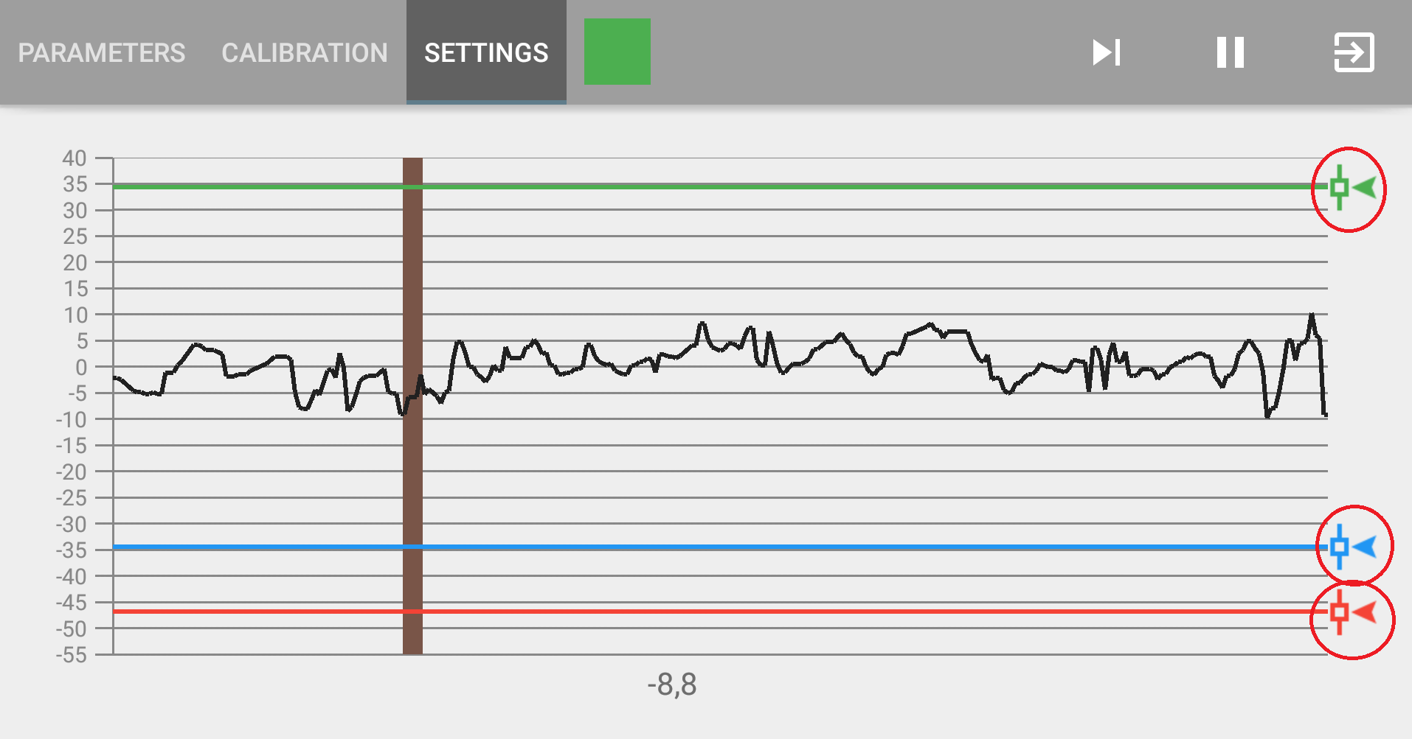
Converter RS-485 in a Bluetooth (BL)
In the Special 1 you can change Tresholds:

Slide 19
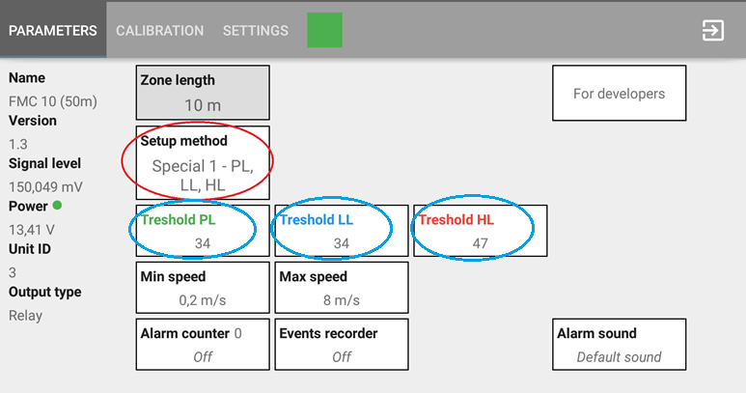
Converter RS-485 in a Bluetooth (BL)
In the Special 1 you can change Tresholds:

Slide 20
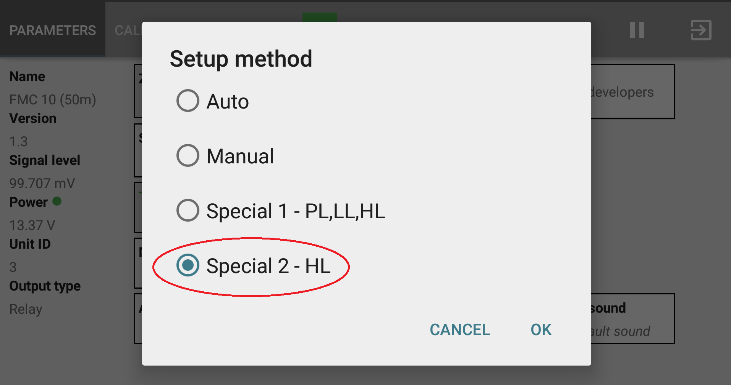
Converter RS-485 in a Bluetooth (BL)
Then you choose setup method: Special 2 – HL

Slide 21
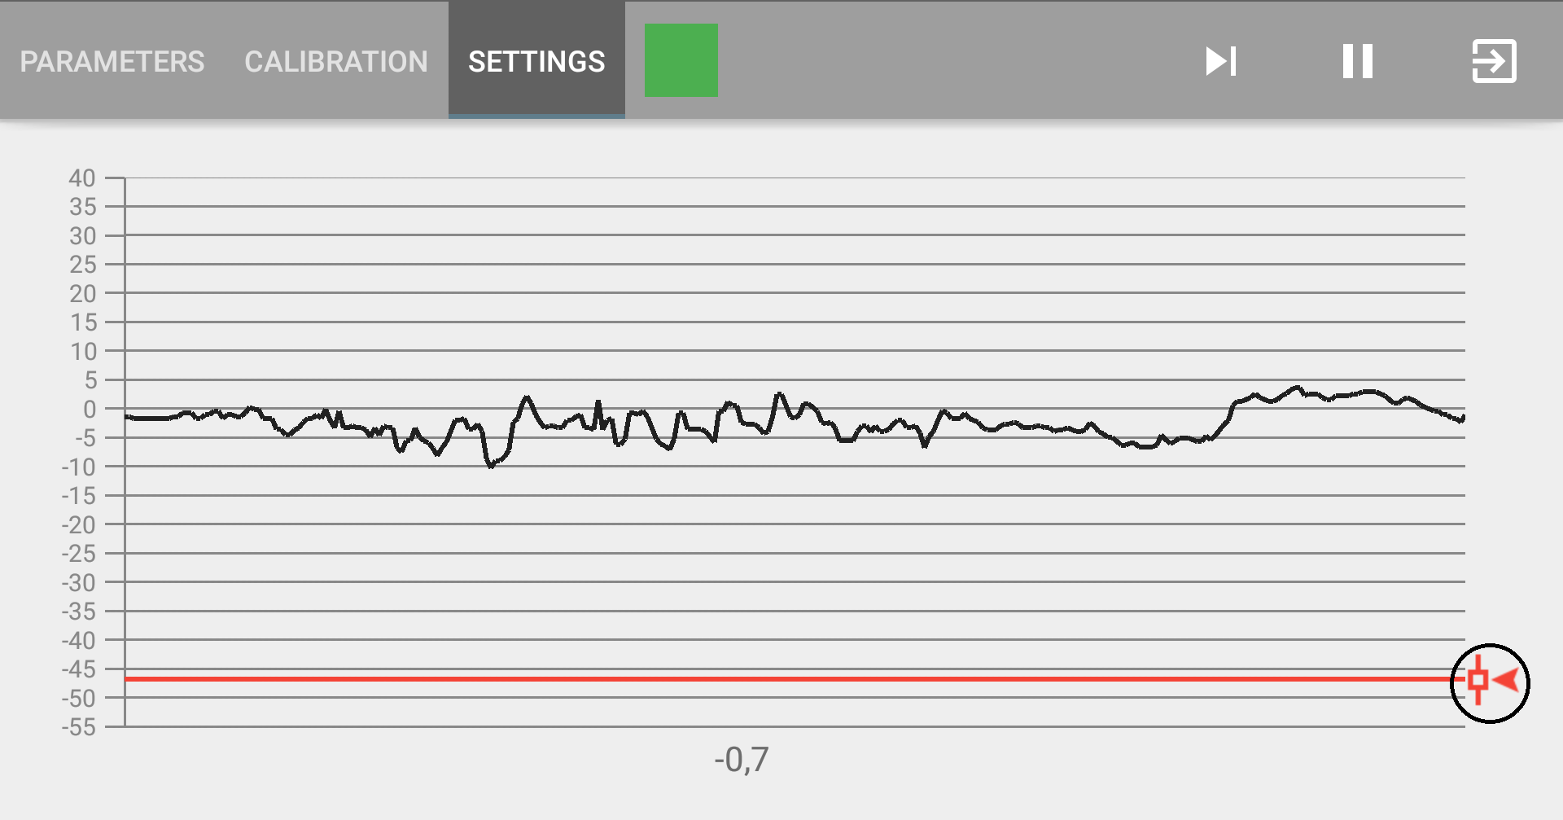
Converter RS-485 in a Bluetooth (BL)
In the Special 2 you can change Treshold :

Slide 22
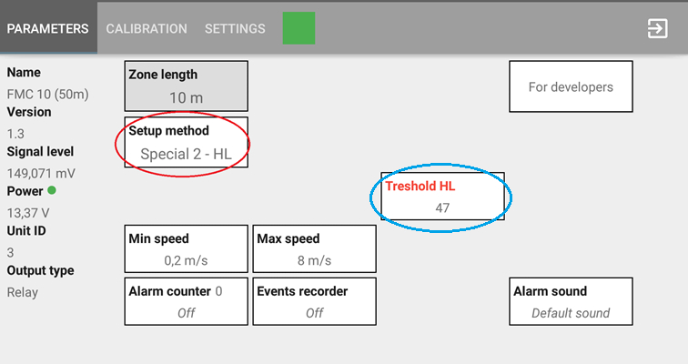
Converter RS-485 in a Bluetooth (BL)
In the Special 2 you can change Treshold HL :

Slide 23
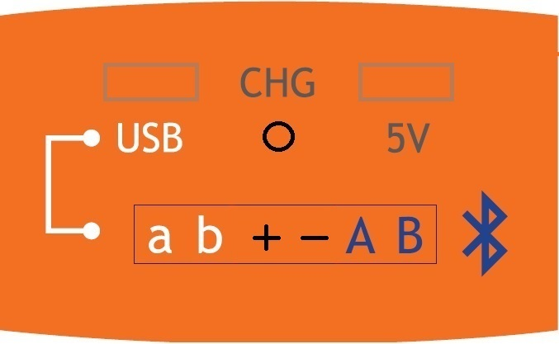
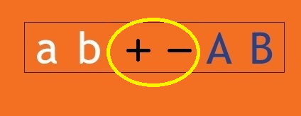
Converter RS-485 in Bluetooth (BL)
Emergency connection supply for BL.(9-30V)
External charging device connection socket.

Slide 24
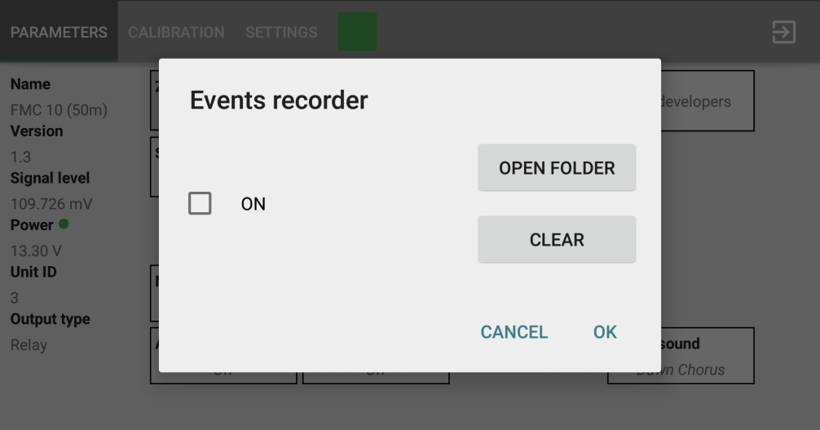
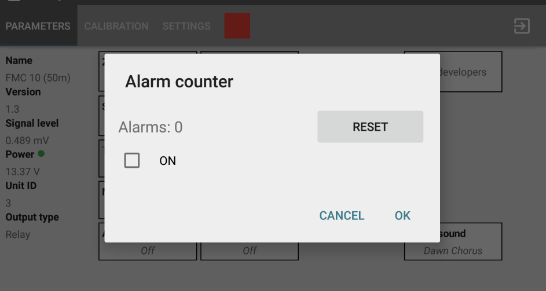
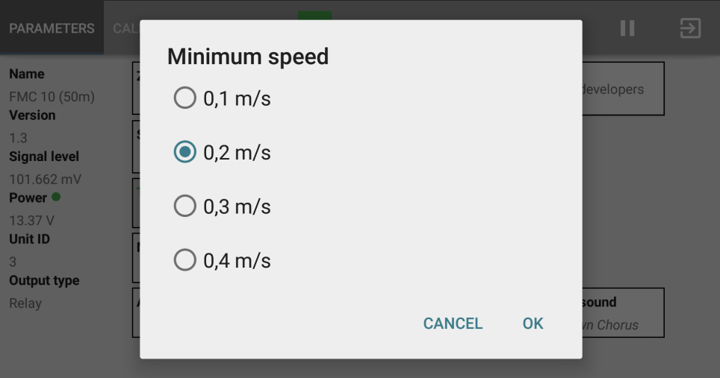
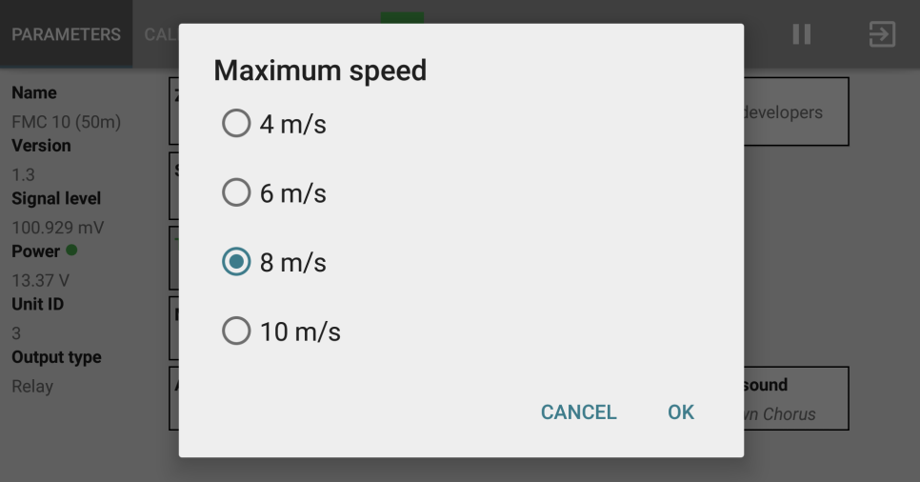
Converter RS-485 in a Bluetooth (BL)
Additional set up functions:

Slide 25
Converter RS-485 in a Bluetooth (BL)
Alarm counter

Slide 26
Converter RS-485 in a Bluetooth (BL)
Events recorder

Slide 27
Converter RS-485 in a Bluetooth (BL)
Minimum speed

Slide 28
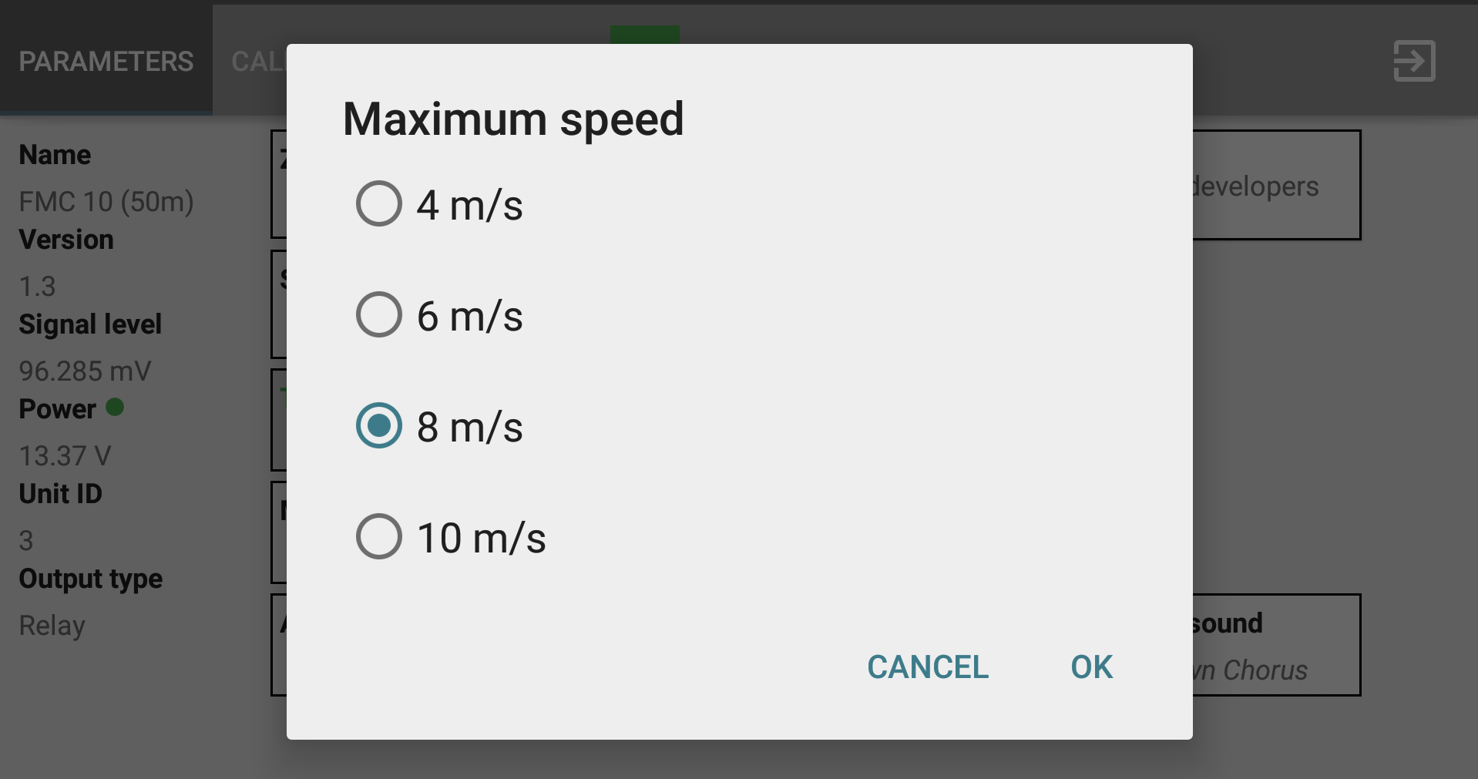
Converter RS-485 in a Bluetooth (BL)
Maximum speed

